Slide 1




Dockless Vehicle Safety
Scooters Considered Harmful

Slide 2
Societal Problems
Dockless transportation is efficient...
Notes:
Sanjay
Electric scooters have been extremely convenient and very accessible, but its not without risks

Slide 3
Societal Problems
Dockless transportation is efficient...
But dangerous.
Notes:
Sanjay

Slide 4
Societal Problems
Nearly 1 million dockless scooter trips taken per month in Austin
Notes:
Helen
1. bone fractures (excluding nose/fingers/toes) (84%),
2. nerve, tendon, or ligament injuries (45%),
3. spending more than 48 hours in the hospital (8%),
4. severe bleed (5%), and
5. sustained organ damage (1%).

Slide 5
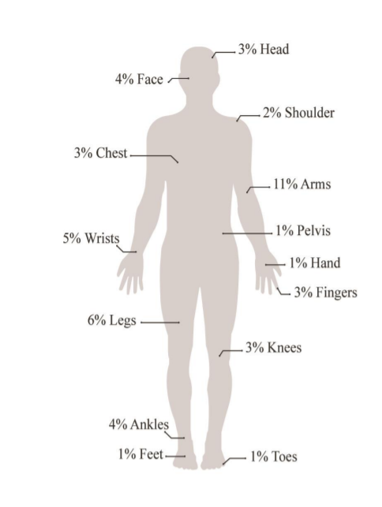
Societal Problems
Nearly 1 million dockless scooter trips taken per month in Austin
271 scooter related injuries that led to a
hospital visit over a three month span
48% of injured riders between ages 18 and 29
Half of these injuries were severe
Likely an underestimate
Bone fracture locations for injured riders
https://austintexas.gov/sites/default/files/files/Health/Epidemiology/APH_Dockless_Electric_Scooter_Study_5-2-19.pdf
Notes:
Helen
1. bone fractures (excluding nose/fingers/toes) (84%),
2. nerve, tendon, or ligament injuries (45%),
3. spending more than 48 hours in the hospital (8%),
4. severe bleed (5%), and
5. sustained organ damage (1%).

Slide 6
Our Contribution / Problem Statement

Slide 7
Our Contribution / Problem Statement
We want to:
Understand and model student pedestrian flow on the UT Austin campus
Notes:
Helen

Slide 8
Our Contribution / Problem Statement
We want to:
Understand and model student pedestrian flow on the UT Austin campus
Simulate potential trouble hotspots for students commuting to class
Notes:
Helen

Slide 9
Our Contribution / Problem Statement
We want to:
Understand and model student pedestrian flow on the UT Austin campus
Simulate potential trouble hotspots for students commuting to class
Evaluate car traffic and pedestrian traffic points of conflict
Notes:
Helen

Slide 10
Ethical Considerations
Privacy
start location + start time ➪ where someone lives and when they’re not home
Notes:
Claire

Slide 11
Ethical Considerations
Privacy
start location + start time ➪ where someone lives and when they’re not home
We want to create a sampling scheme that anonymizes the data.
Notes:
Claire

Slide 12
Criteria of Success
Develop a sampling technique for scooter traffic around UT Austin
Consider as many variables as we can to enhance our model
Validate on original Austin Scooter dataset
Locate regions of high scooter activity (“hotspots for injury”)
Notes:
Claire

Slide 13
Criteria of Success
Develop a sampling technique for scooter traffic around UT Austin
Consider as many variables as we can to enhance our model
Validate on original Austin Scooter dataset
Locate regions of high scooter activity (“hotspots for injury”)
Unsupervised Learning: learning hidden structure in the data,
then generating more data
Notes:
Nimit

Slide 14






Our Thought Process
?????

Slide 15
Our Thought Process
“Alice leaves ApartmentB at 9:45 AM for a 10 AM class in GDC. Her apartment is 10 minutes away, so this makes sense.”
Notes:
Nimit

Slide 16
Our Thought Process
“Alice leaves ApartmentB at 9:45 AM for a 10 AM class in GDC. Her apartment is 10 minutes away, so this makes sense.”
So should we look at P(start_time | start_location, end_location)?
Notes:
Nimit

Slide 17
Our Thought Process
“Alice leaves ApartmentB at 9:45 AM for a 10 AM class in GDC. Her apartment is 10 minutes away, so this makes sense.”
So should we look at P(start_time | start_location, end_location)?
But we need to sample start_location and end_location...
Notes:
Nimit

Slide 18
Our Thought Process
“Alice leaves ApartmentB at 9:45 AM for a 10 AM class in GDC Her apartment is 10 minutes away, so this makes sense.”
So should we look at P(start_time | start_location, end_location)?
But we need to sample start_location and end_location...
Notes:
Nimit
all we have is the bolded data; need to infer location of ApartmentB

Slide 19
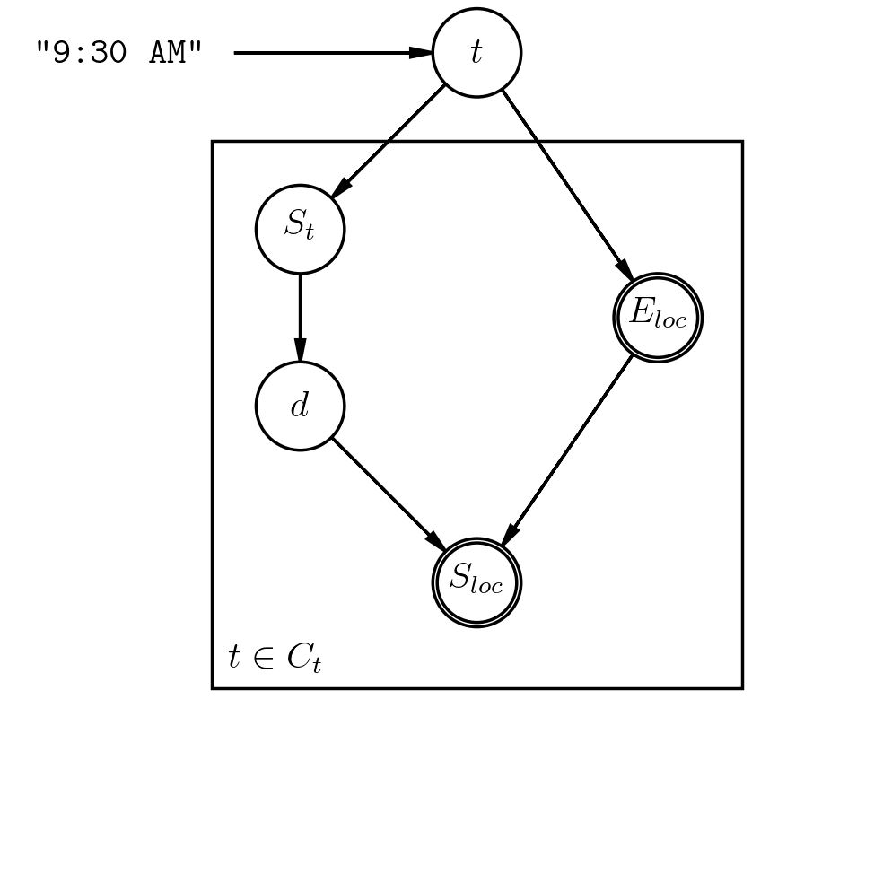
The Bayes Net
Notes:
Sanjay
start_time is scooter start (Austin Scooter dataset)
E_loc is class (course schedule dataset)
d is distance (Austin Scooter dataset)
S_loc is starting region (upper west campus, north campus, etc.)

Slide 20
Why Bayes?
cause-effect relationship
have domain-knowledge
discrete domain
join and sample from distributions across datasets (class times)
joint probability table would be huge
Notes:
Sanjay
start_time is scooter start (Austin Scooter dataset)
E_loc is class (course schedule dataset)
d is distance (Austin Scooter dataset)
S_loc is starting region (upper west campus, north campus, etc.)

Slide 21

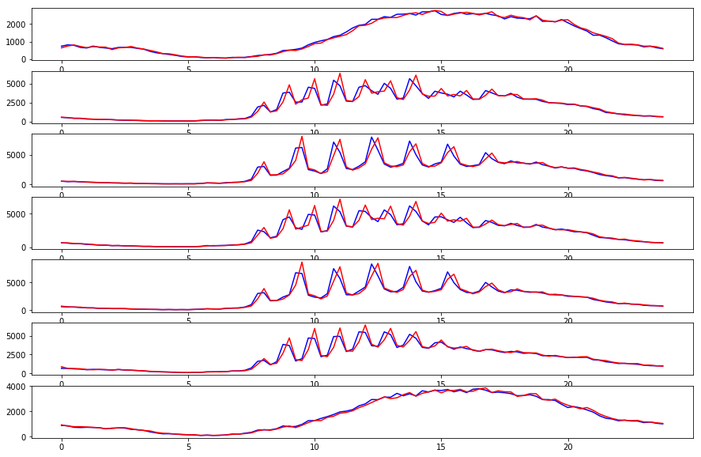
Notes:
Helen

Slide 22
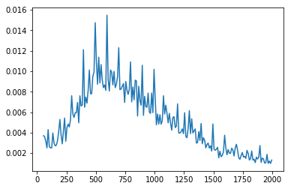
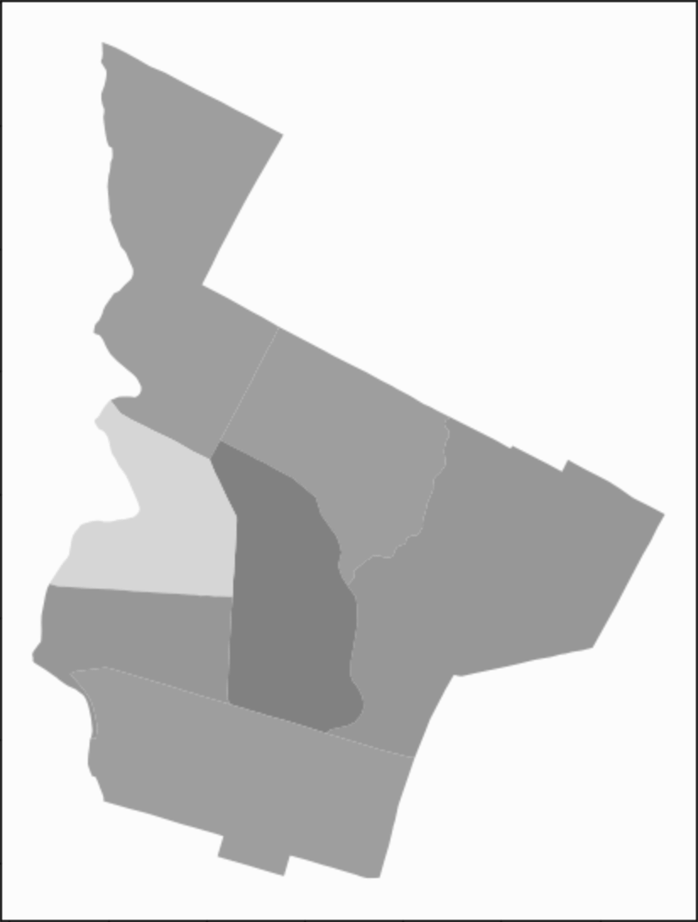
Laplace Smoothing with prior strength k = 5.0
Distance
Notes:
Nimit

Slide 23
Generating Samples
Rejection Sampling from entire dataset bad model, privacy concern, very slow
Notes:
Nimit
StartTime close to ClassTime
bad model: doesn’t incorporate distribution of course schedule times for end locations

Slide 24

Generating Samples
Rejection Sampling from entire dataset bad model, privacy concern, very slow
A Scooter Trip = StartTime + StartLocation + Distance + EndLocation Sample (with S_t within 30 minutes of class time) dataset has ~1 million rides near campus
Notes:
Nimit
StartTime close to ClassTime
bad model: doesn’t incorporate distribution of course schedule times for end locations

Slide 25
Generating Samples
Prior/Forward sampling from BayesNet still too slow
Notes:
Nimit

Slide 26

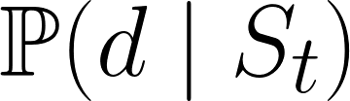


Generating Samples
Prior/Forward sampling from BayesNet still too slow: 25 min for 5k samples (~0.3 sec/sample)
Notes:
Nimit

Slide 27

Generating Samples
Gibbs (approximate) sampling from BayesNet better!
Run Prior/Forward Sampling
Pick one variable at random
Resample it! (conditioned on evidence)
Notes:
Nimit

Slide 28
Generating Samples
1.5 min for 5k samples! (~0.018 sec/sample)
Gibbs (approximate) sampling from BayesNet better!
Run Prior/Forward Sampling
Pick one variable at random
Resample it! (conditioned on evidence)
Notes:
Nimit

Slide 29
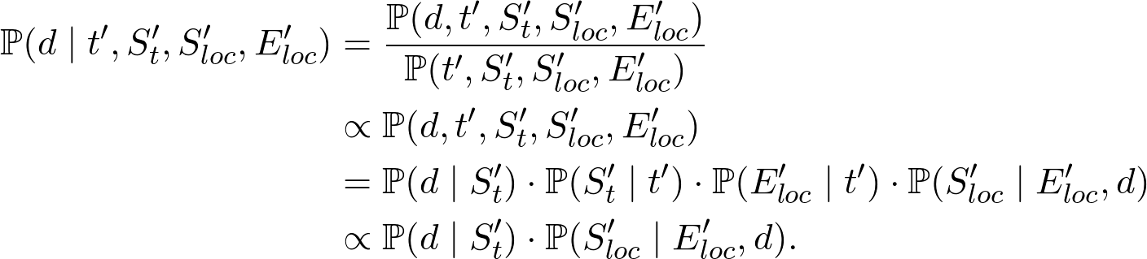
Normalize and sample! Repeat...
1.5 min for 5k samples (~0.018 sec/sample)

Slide 30
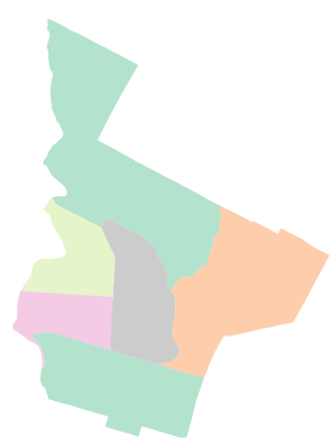
Simulation
Input: (region ID, building name)
EX: (000500, “RLM”)
Output: shortest path between the two points
Repeat for 5,000 generated samples:
Randomly sample point from start region
Convert building to latitude-longitude
Find shortest path
Result: Heatmap
BUR
MRH
MEZ
RLP
Notes:
Claire

Slide 31
Our Findings

Slide 32
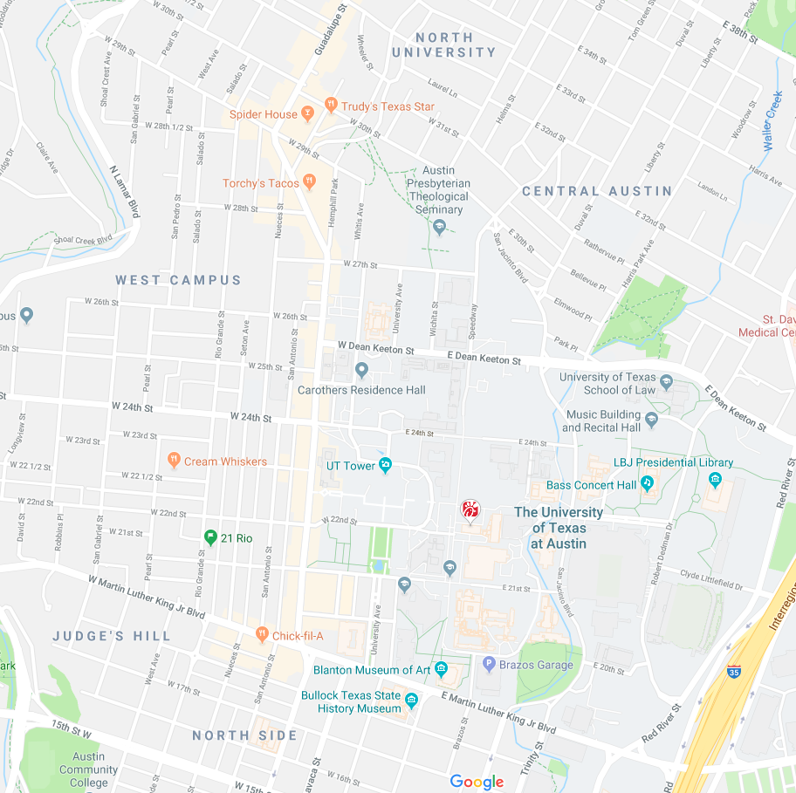
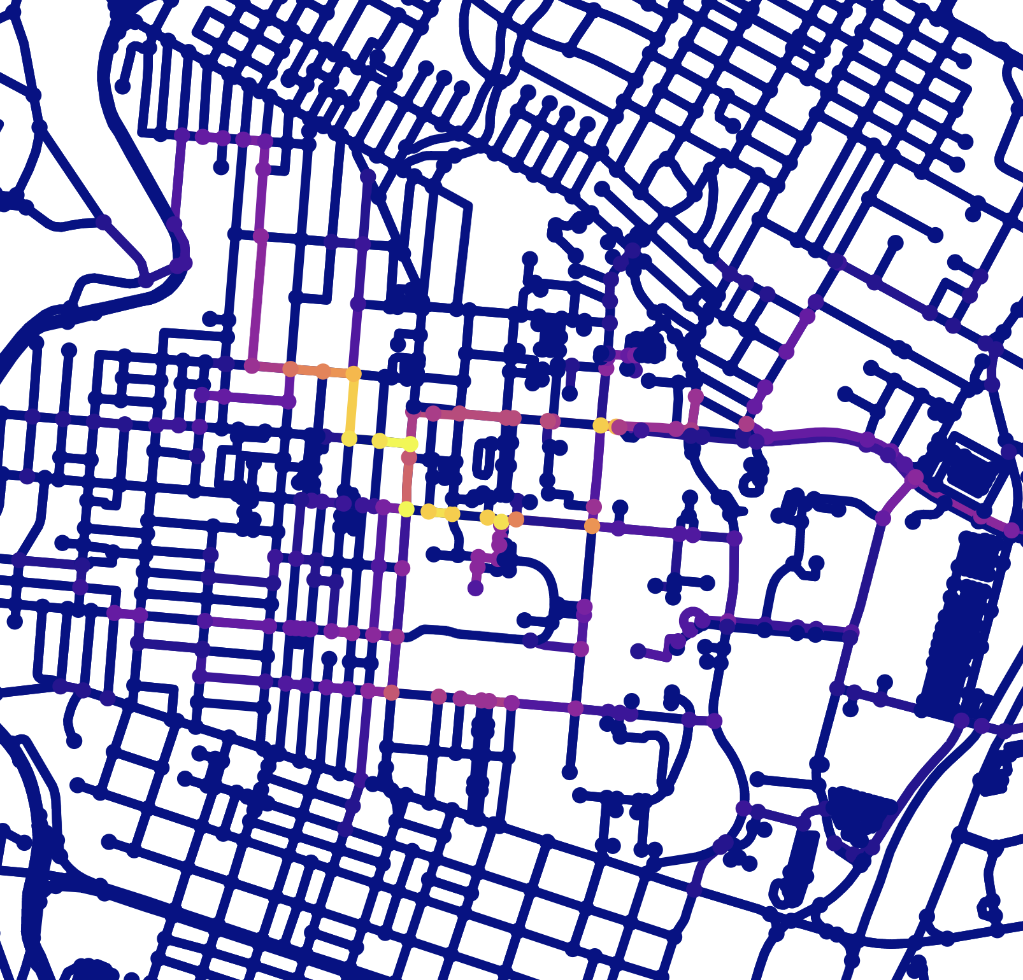
1
0
Notes:
Sanjay
From our results we are able to identify key intersections where there is a high volume of traffic. Such as 26th, 24th, 21st.
45000 scooter rides simulated here.
...

Slide 33
Evaluation
Sanity Checks
Sampled known points around campus and checked distances
Made sure distributions make sense ( has gaps at night, etc.)
Data pre-processing; removed outliers/errors

Slide 34
Evaluation
Sanity Checks
Sampled known points around campus and checked distances
Made sure distributions make sense ( has gaps at night, etc.)
Data pre-processing; removed outliers/errors
Validation
Chi-squared goodness-of-fit test to check generated sample distributions
p=0.996 on distribution of start_regions + end_regions
Overfitting/Bagging not necessary since our dataset is the entire population
Notes:
Nimit

Slide 35

Evaluation
Chi-squared independence test between dependent distributions
if S_t observed,
d independent from t
Notes:
Nimit

Slide 36
Issues
Ethical implications
bias towards more financially secure individuals
living close to campus (expensive)
can afford to spend money on scooters
have smartphones + internet (data)
Privacy concerns of real-time online scooter dataset
Large domain of variables
Notes:
Sanjay

Slide 37
Future Work
Weather
Other MCMC sampling techniques
Create a pedestrian dataset
scooters and people go toward the same places
Include motor vehicle data
overlaps/intersections can indicate hotspots for accidents
reroute existing traffic for safer interactions
Notes:
Helen

Slide 38
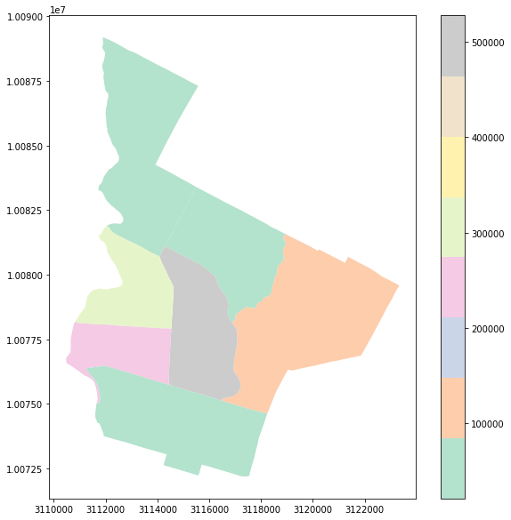
The Data
Austin, TX Census¹
Dockless Vehicle Trips²
Fall 2019 Class Schedule³
Population Density
GDC
¹http://www.austintexas.gov/page/demographic-data
²https://data.austintexas.gov/Transportation-and-Mobility/Dockless-Vehicle-Trips/7d8e-dm7r
³https://registrar.utexas.edu/schedules/189
Frequency of End Locations
Notes:
Claire
all we have is the bolded data; need to infer location of ApartmentB

